Slide 1


DATA ANALYTICS
BOOTCAMP
Final Project 2022

Slide 2
Team Blue
Gajardoni, Ana
Trasher, Kristi
Gonzalez, David
Final Project 2022

Slide 3

Topic
Speed Dating
Reason why we selected this topic
Fun topic that meets requirements for the machine learning project.
Data Source Description
The dataset contains data that was gathered from a speed dating experiments from 2002-2004. This experiment consisted of participants of the opposite sex engaging in a 4-minute conversation with one another. Each participant then gave a ranking on their perception of the other person for several attributes including attractiveness, sincerity, intelligence, fun, ambition, ands shared interests ,demographics, dating habits, self-perception across key attributes, beliefs on what others find valuable in a mate, and lifestyle information. Dataset contains 195 attributes.
Final Project 2022

Slide 4

Questions we hope to answer with the data
Can a machine learning model help in predicting and/or improving the speed dating process?
Output is Match or No Match based on input data from speed dating experiment.
Final Project 2022

Slide 5
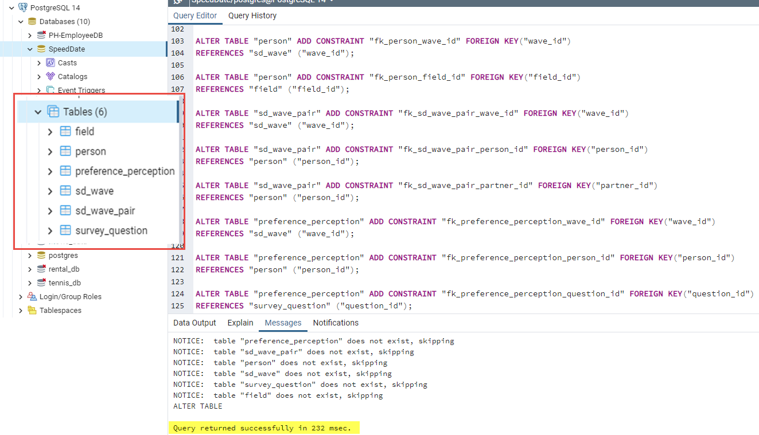
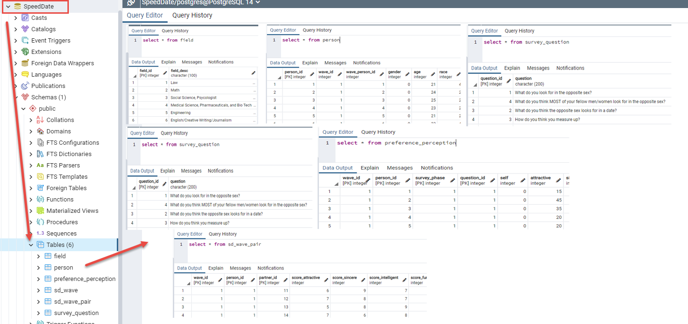
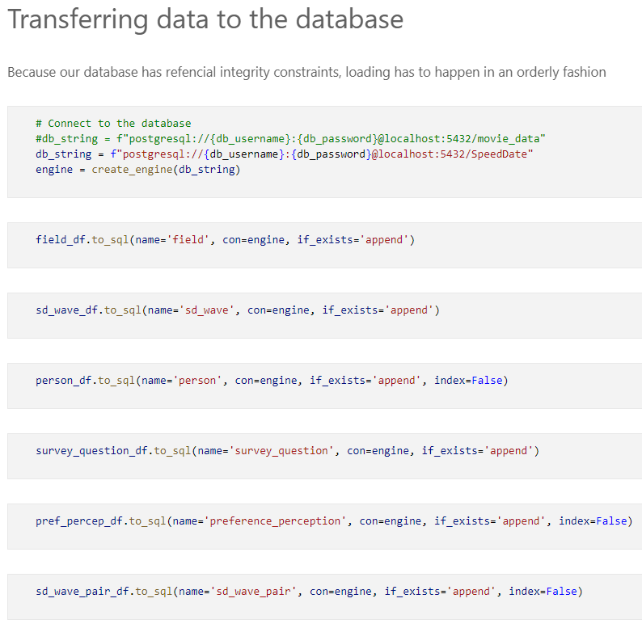
Database Creation (DB Name: SpeedDate)
Final Project 2022

Slide 6
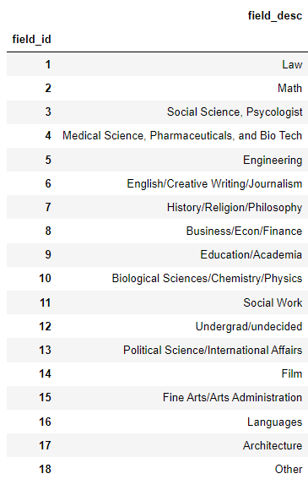
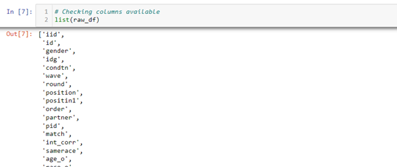
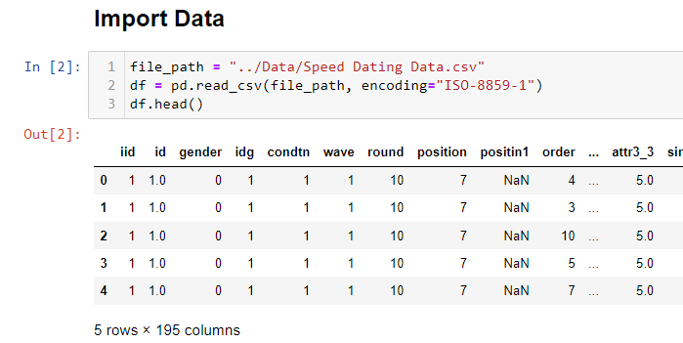
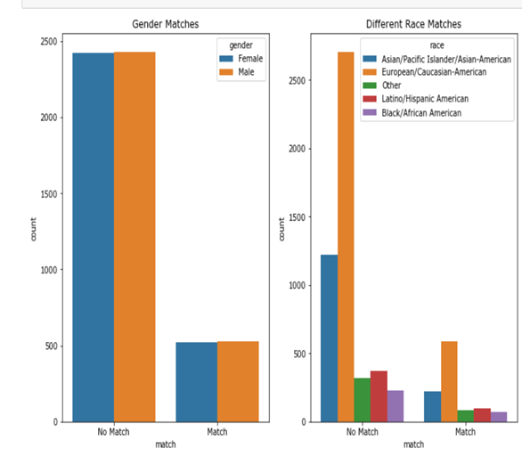
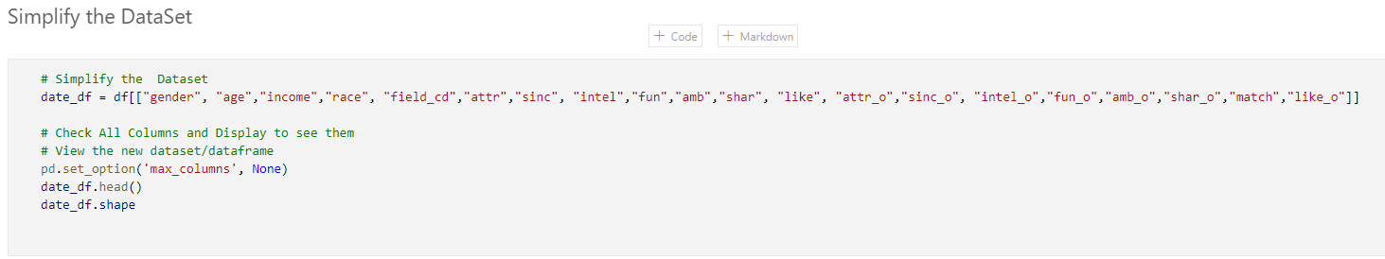
Data Exploration Phase Description
Final Project 2022

Slide 7

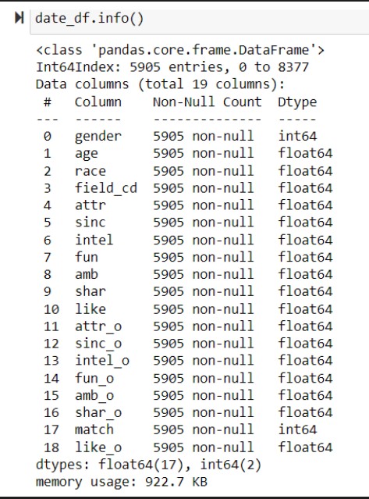
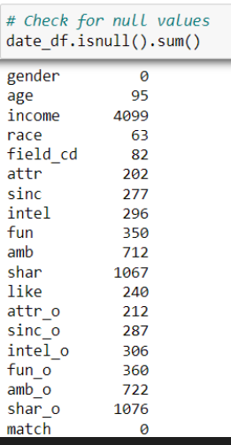
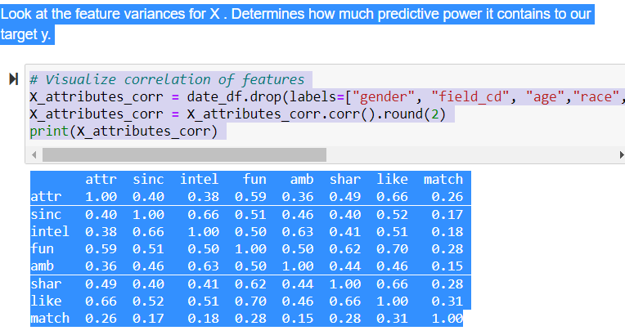
Data Cleaning
Check for Null Values
Drop null values or performed imputations
Check Correlation of features
Check data types
Final Project 2022

Slide 8
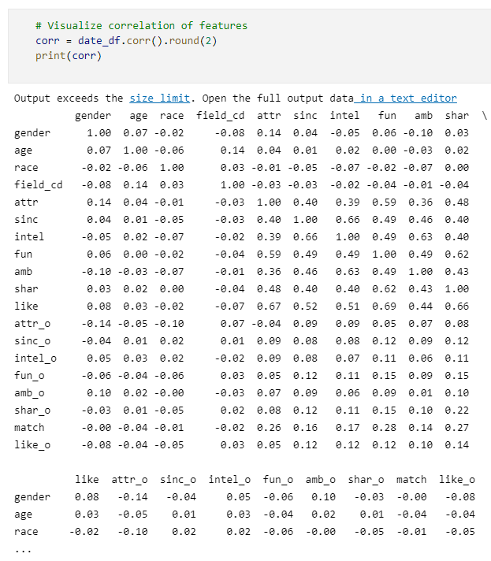
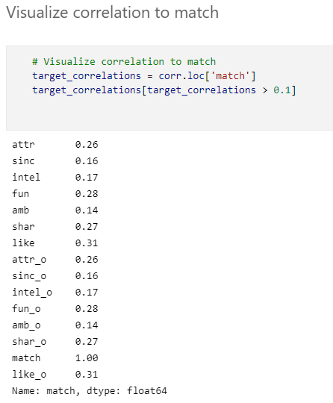
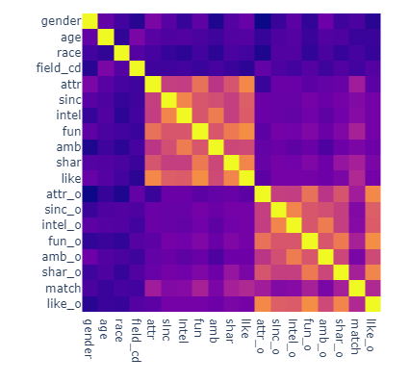
Analysis Phase Description
In supervised learning the algorithms use data that is labeled. The
algorithm determines which label should be given to new data by
associating patterns to the unlabeled new data. Classification
Predicts the category that the unlabeled new data belongs to.
Final Project 2022

Slide 9
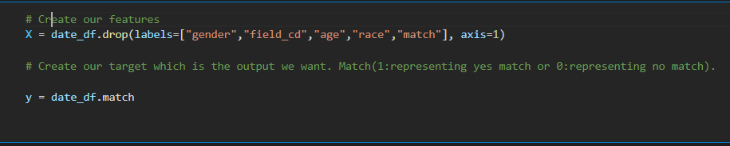
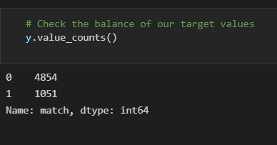
Analysis Phase: Feature Selection
X: Independent Variables
Y: Target Variable
Final Project 2022

Slide 10
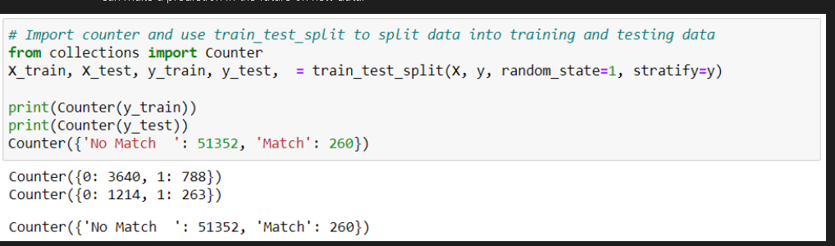
Analysis Phase: Data Splitting
Training Set:80%
Test Set: 20%
Predictors: X
Target: Match or No match
Data: Ready to Train Model
Final Project 2022

Slide 11
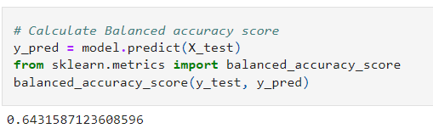
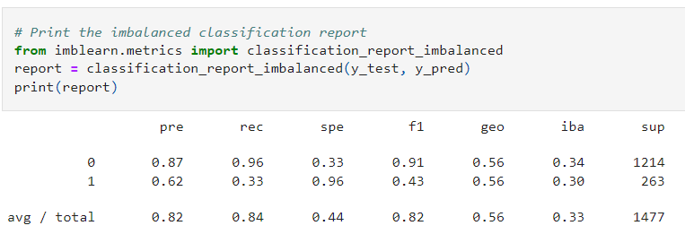
Results of Analysis
Logistic Regression Model
We see from accuracy score we had a 0.64% chance of predicting correctly a match.
The Classification Report showed an F1 score of .82 and Precision score of .82, Recall Score of .84.
Note: Precision Score measures the proportion of correct positive predictions
Recall Score measures the coverage of actual positive labels.
F1 Score is the harmonic mean of the precision score and the recall score.
Final Project 2022

Slide 12
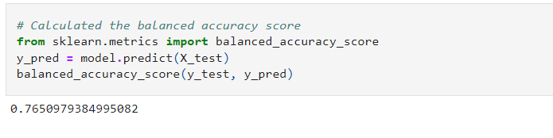
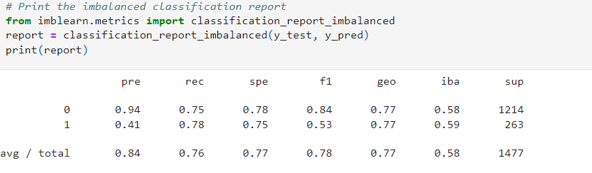
Results of Analysis
Balanced Random Forest Model
We see from accuracy score we had a 0.77% chance of predicting correctly a match.
The Classification Report showed an F1 score of .78 and Precision score of .84, Recall Score of .76.
Note: Precision Score measures the proportion of correct positive predictions
Recall Score measures the coverage of actual positive labels.
F1 Score is the harmonic mean of the precision score and the recall score.
Final Project 2022

Slide 13
Recommendations for future analysis
Further the feature engineering by selection of new features.
Final Project 2022

Slide 14






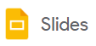

Technologies, Languages, Tools, and Algorithms
Development
Environment
Data
Management
Languages
Data
Visualization
Algorithms
Supervised Machine Learning
Logistic Regression
Naïve Bayes
Balanced Random Forest
Final Project 2022

